Slide 1
Spirit Electrical
Power System
Design Overview

Slide 2
Design Approach
EPS Components | Mass (g) | Price ($CDN) | Dimensions (mm) | Operating Temperature | BOL Efficiency | Operating Voltage (V) | Product Link | Notes
Solar Panels | 100 | $ 5,198.66 | ~ | -40 to +125°C | 30% | 3.0 | https://www.isispace.nl/product/isis-cubesat-solar-panels/ | GaAs Triple-junction solar cells, better than Si b/c lighter, better efficiency, better resistance to radiation
 | 100 | $ 5,900.00 | 82.5 x 196 x 2.4 | -55°C to +125°C | 30% | 3.3 | https://www.cubesatshop.com/product/cubesat-solar-panels/ | Similar option but solar cells are delivered in smaller units
 | 53 | ~ | 98 x 82.6 x 9.0 | -40 to +105°C | 29.50% | 4.66 | https://www.endurosat.com/products/cubesat-solar-panels-x-y/ | 1U Solar Panel
Battery and Power Supply | 200 | $3000 - 4000 | 89.3 x 92.9 x 25.9 | -40 °C to +85 °C | 95% | 3.3 or 5.0 | https://gomspace.com/shop/subsystems/power-supplies/nanopower-p31u.aspx | Lithium-ion's key advantage or NiCa is the increased energy density and low maintenance
 | 278 | $ 3,700.00 | 90.2 x 95.9 x 30.0 | -40 to +150°C | 95% | 3.3 or 5.0 | https://www.endurosat.com/products/cubesat-power-module/ | LiPo battery with 20.8 Wh

Slide 3
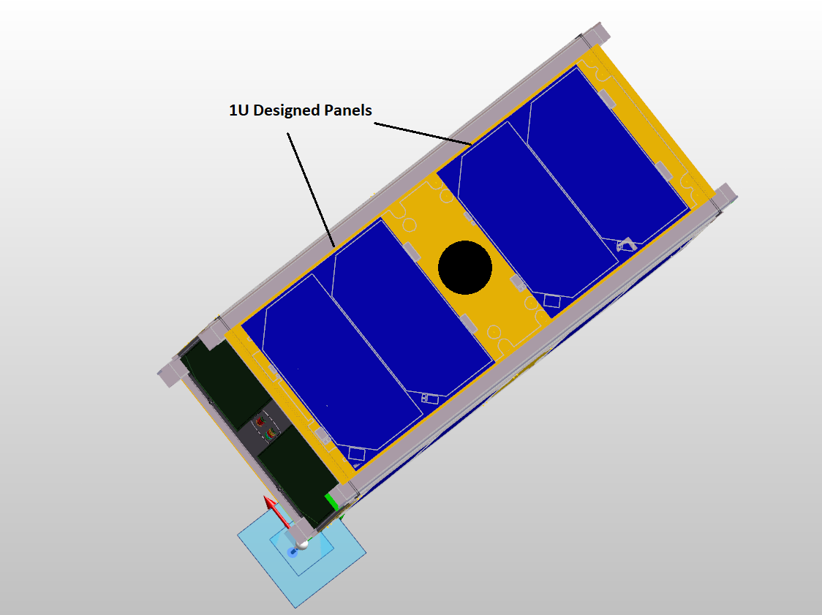
CubeSat Design Configuration

Slide 4
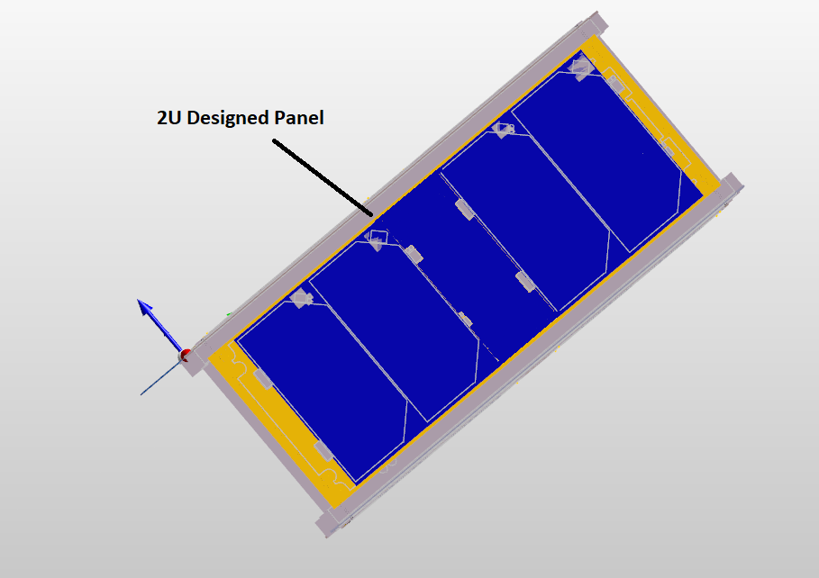
CubeSat Design Configuration

Slide 5
Power Budget
Components |  | Nominal | COMMS | Imaging | Safe | Eclipse
Subsystem | Component | Power (W) | Power (W) | Power (W) | Power (W) | Power (W)
COMM | Transmission | 0.00 | 4.95 | 0.00 | 0.00 | 0.00
 | Receiving | 1.00 | 1.00 | 0.00 | 0.00 | 0.00
subtotal |  | 1.00 | 5.95 | 0.00 | 0.00 | 0.00
C&DH | On-Board Computer | 0.55 | 0.55 | 0.55 | 0.55 | 0.55
subtotal |  | 0.55 | 0.55 | 0.55 | 0.55 | 0.55
ADCS | magnetorquer | 0.00 | 0.00 | 0.00 | 0.00 | 0.00
 | sun sensor | 0.05 | 0.05 | 0.05 | 0.00 | 0.00
 | reaction wheel | 0.00 | 2.20 | 2.20 | 0.00 | 2.20
 | Gyroscope | 0.01 | 0.01 | 0.00 | 0.00 | 0.00
subtotal |  | 0.06 | 2.26 | 2.25 | 0.00 | 2.20
payload | camera 1 | 0.00 | 0.00 | 3.00 | 0.00 | 0.00
*Voltages are estimates | camera 2 | 0.00 | 0.00 | 3.00 | 0.00 | 0.00
subtotal |  | 0.00 | 0.00 | 6.00 | 0.00 | 0.00
Power Requirement |  | 1.61 | 8.76 | 8.80 | 0.55 | 2.75
Power Consumption (Whr) |  | 2.99 | 4.78 | 2.91 | 0.83 | 2.99
*This power budget assumes an orbit of 90.0 minutes, separated into 60.0 minutes of sunlight and 30.0 minutes of eclipse. Nominal power generation at BOL is 3.1Watts in ideal conditions.

Slide 6
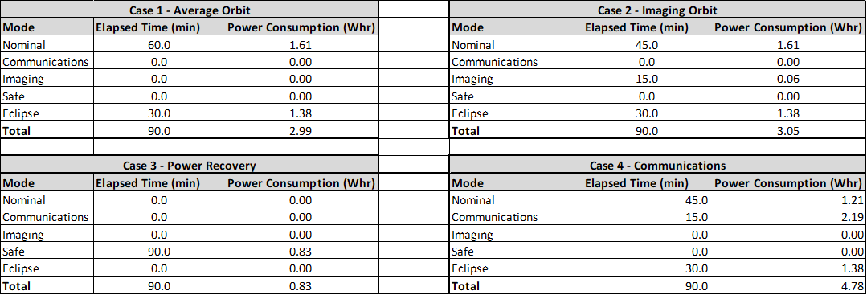
Power Consumption Calculations

Slide 7
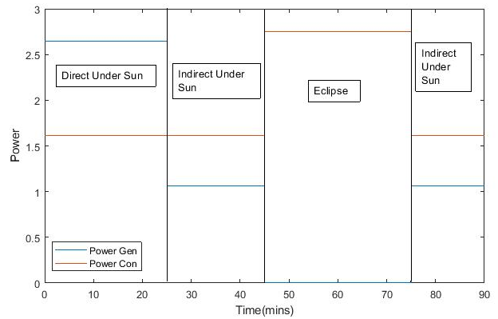
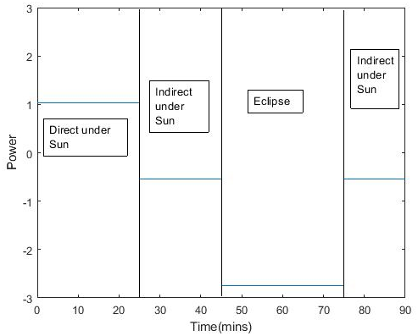
Nominal Mode Model
Power Conditions for 1 Orbit
Generation/Consumption
Net Power
*These values assume ideal beginning of life conditions with 25 mins of direct sunlight, 35 mins of angled sunlight and 30 mins of eclipse*

Slide 8
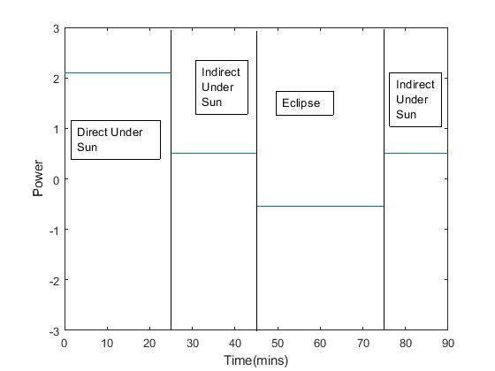
Safe Mode Model
Power Conditions for 1 Orbit
*These values assume ideal beginning of life conditions with 25 mins of direct sunlight, 35 mins of angled sunlight and 30 mins of eclipse*

Slide 9
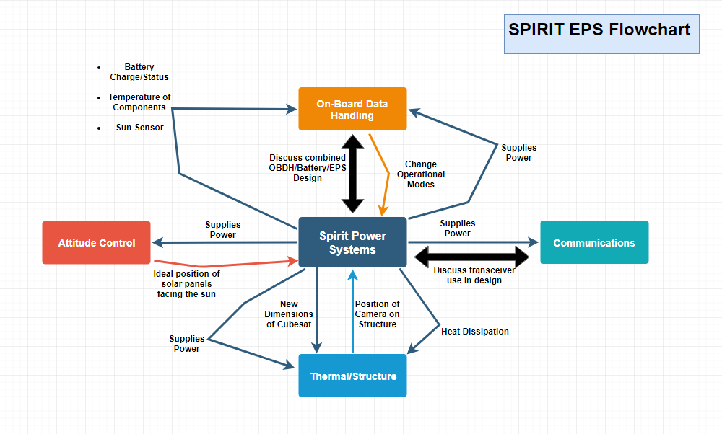
Subsystem Interaction

